Slide 1
Automated Transport Vehicle
MICHAEL ESPOSITO
B.S., COMPUTER SCIENCE
EMAIL: MICHAEL5486@GWU.EDU
CELL: (908) 418-1063

Slide 2
ATV Project Goals
Help disabled individuals carry heavy objects up to 20 pounds
Require little user intervention, fully autonomous navigation
Avoid obstacles
Utilizes three main components

Slide 3
Main Project Components
Cargo area
Robot chassis, motor and movement control system
RGB and Infrared cameras for user/object detection

Slide 4
Cargo Area
Consists of a motorized door, one button to open and close
Must close slowly to prevent injury to the user

Slide 5
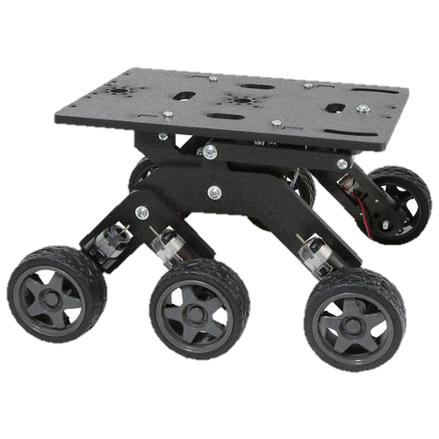
Chassis
Mechanical construction provides multi-terrain capabilities, ability to carry heavy loads
Basic water-resistance and remain undamaged from expected forces and wear and tear

Slide 6
User/Object Detection System
Hardware – Intel RealSense R200, UP Board
RealSense R200
RGB camera
stereoscopic IR for depth
UP Board
Small board
runs full Linux/Windows distros
GPIO, USB pins for interaction with motors and other hardware components
More RAM allows for computationally-expensive image analysis

Slide 7
User/Object Detection System
Software – Ubuntu, librealsense, ROS
Ubuntu – integrates the RealSense Camera, Input/Output Ports, and algorithmic components
Librealsense – open source library for using RealSense on Linux
ROS (Robot Operating System) – separates and integrates modular components of vision analysis, object avoidance algorithms, and motor control

Slide 8
How Are the Pieces Integrated?
User detection + obstacle detection are simultaneously running processes
Robot switches between the two processes for motor control
Depends upon whether or not the user is in robot’s field of view
ROS will help to manage the different sub-processes that will need to communicate

Slide 9
Any questions?

